Slide 1


Beyond Silos
Inter-Diocesan Collaboration

Slide 2
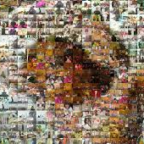
One Body in Christ
Living the truth in love, we should grow in every way into him who is the head, Christ, from whom the whole body, joined and held together by every supporting ligament, with the proper functioning of each part, brings about the body’s growth and builds itself up in love. (Eph 4:15-16)

Slide 3
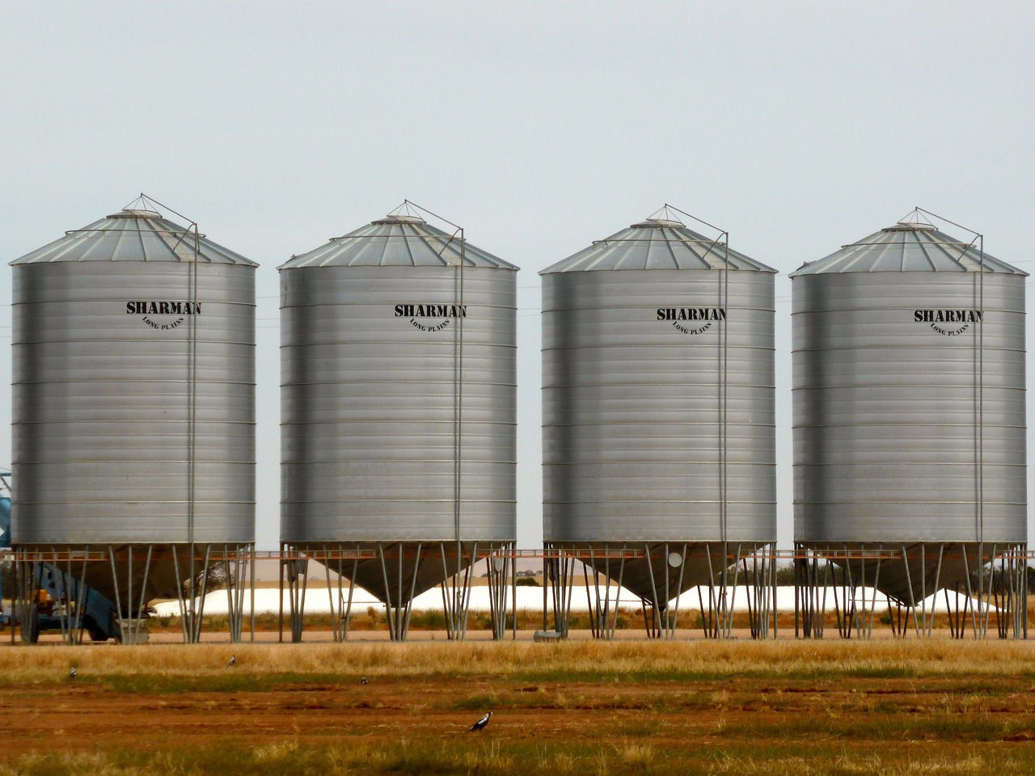
What is a Silo?
Organizational divisions that operate independently and avoid sharing information.
(www.Investopedia.com)
Notes:
A drench, pit, or especially a tall cylinder (as of wood or concrete) usually sealed to exclude air and used for making and storing silage. Webster

Slide 4
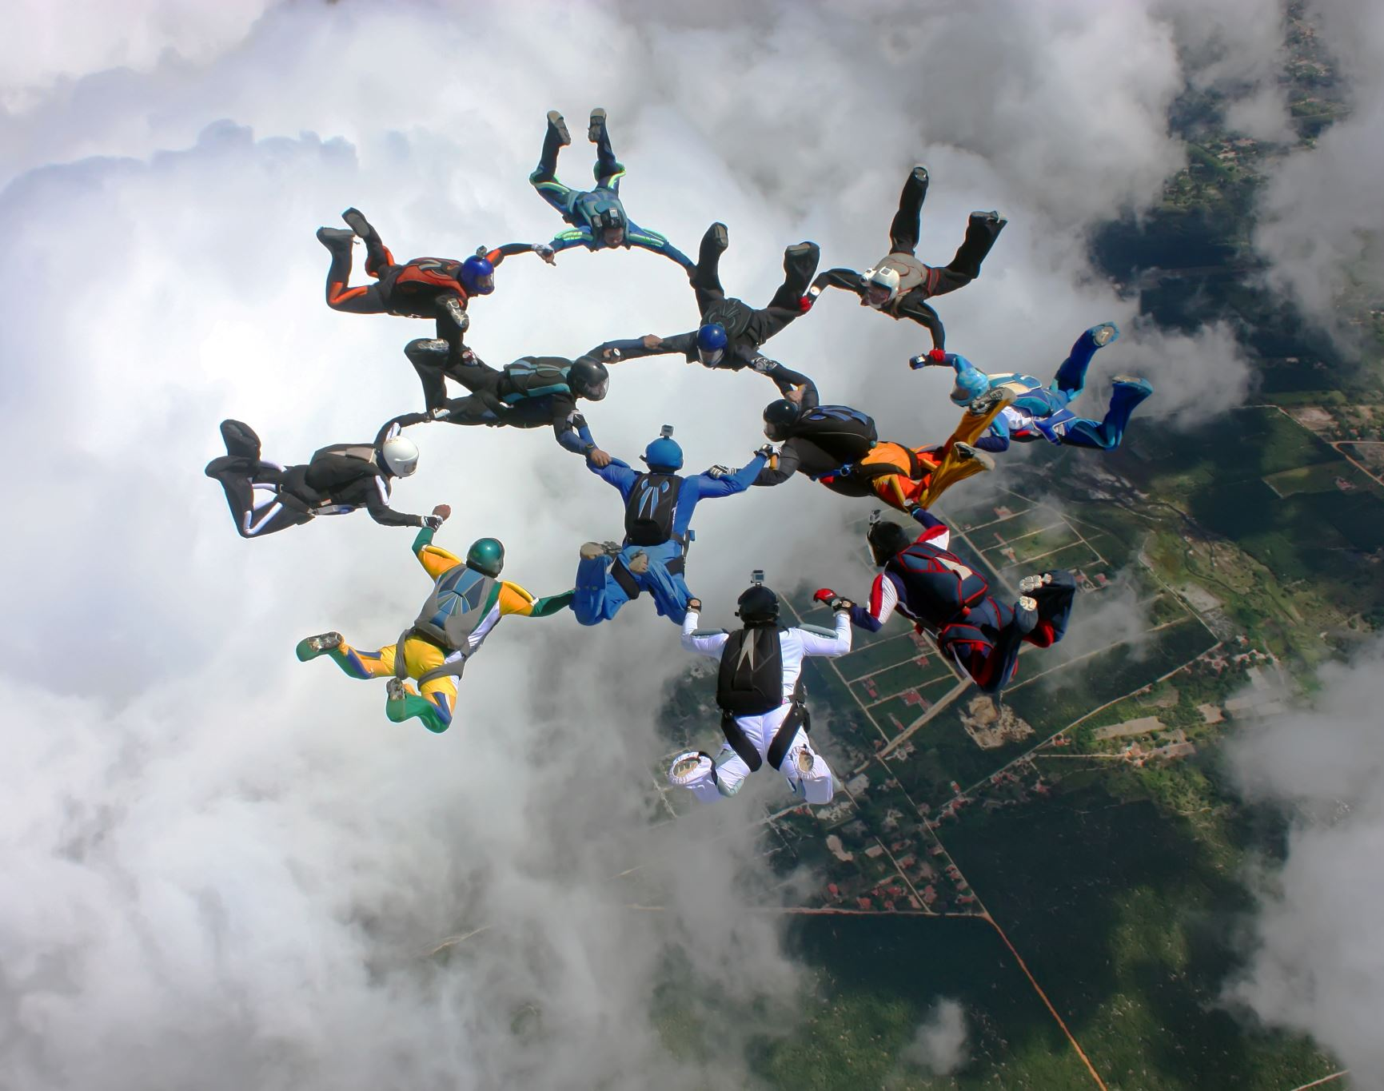
Discussion
Why do ministry silos hurt or impede the work in Natural Family Planning?
What do we do to prevent silos?
How can we work better with the various methods of NFP to build a stronger voice?

Slide 5

Collaboration Model
Christ
Cenacle
Communio
Cooperation
Communication
Compassion
Co-responsibility
7-Keys to Christ-Centered Collaboration Fr. Frank Donio, S.A.C. and Barbara McCrabb - Summer 2023 Horizon Magazine

Slide 6
Collaborate OR NOT
Natural Family Planning Ministry can flow in Christ with
Accompaniment
Compassion
Collaboration
OR
Natural Family Planning Ministry can flow from us alone with
Pressure to perform
Reacting instead of being proactive
Run from one fire to the next.

Slide 7
Other Dioceses/Diocesan Departments
Which departments?
Why? Focus to complete a task or focus on completing a task with all impacted or passionate about it.

Slide 8
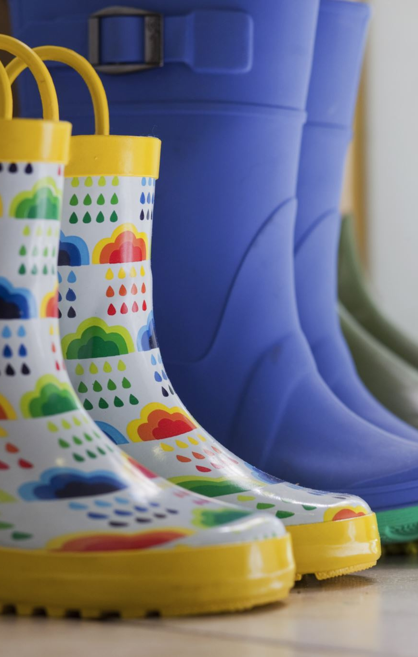
Building Missionary NFP Workers
Places to intersect:
Stages of Marriage Preparation: Remote, Proximate, and Immediate
Marriage Enrichment
Couple and Family Apostolates
Healing Ministry
Support for Struggling Marriages/Family
Infertility Ministry

Slide 9

First steps to success
Pray together.
Set up meetings with all the relevant departments. You could also call the department heads together for a strategic planning meeting.
Meet with the pastor at each parish individual. Ask HIM what he NEEDS.
Be Not Afraid

Slide 10

Prayer for Moving Forward
God our loving Father,
we place our work and ourselves into Your Hands.
Anoint our creativity, our plans, our work
so that even the smallest task may bring You glory.
When we are challenged, guide us, when we are weary, energize us.
May the work that we do and the way that we do it, bring hope, life and courage to all with whom
we minister within our dioceses.
Bless our bishops and priests with wisdom and discernment,
our entire staff with commitment and compassion, and all department heads with a collaborative spirit.
Rooted in Your love may Your face illuminate all activities done in Your name.
Amen
Adapted from St. Joseph Candler

